Slide 1
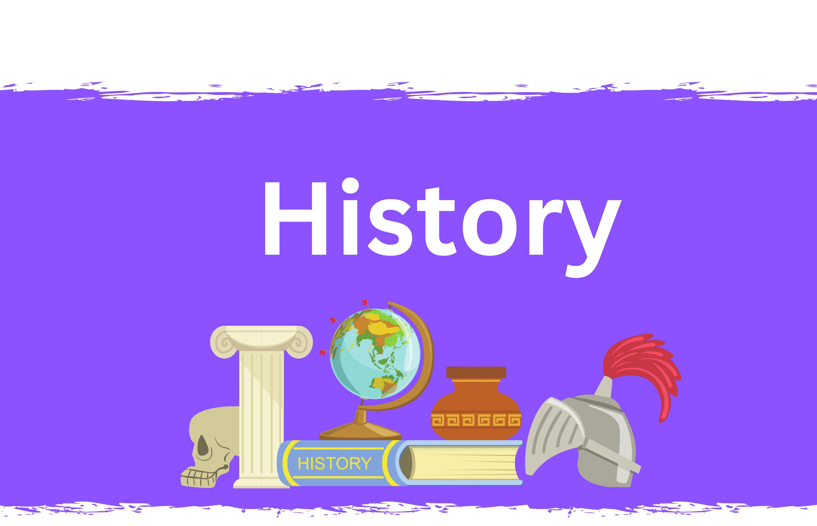

Sentence Stems

Slide 2



© Clive Davies 2025
All rights reserved
Reproduction, storage, adaptation or translation, in any form or by any means, of this publication is prohibited without the prior written permission of the publisher. Excerpts may be reproduced for the purpose of research, private study, criticism or review, or by educational institutions solely for educational purposes, without permission, providing full acknowledgement is given.
This publication should only be used by the purchasing organisation or individual. Focus Education does not grant permission for the purchaser to distribute the content of this publication outside their organisation, this includes placing the whole document or parts on social media or internet sites.
First Published in the UK in 2025 by Focus Education (UK) Ltd
Focus Education (UK) Ltd
Publishing
10 Colstone Close
Wilmslow
Cheshire
SK9 2TF
Focus Education (UK) Ltd Reg. No 4507968
Companies, institutions and other organisations wishing to make bulk purchases of books published by Focus Education should contact their local bookstore or Focus Education direct:
Customer Services, Focus Education, 10 Colstone Close, Wilmslow, Cheshire, SK9 2TF
Tel 01457 821818
www.focus-education.co.uk
customerservice@focus-education.co.uk
2
© Focus Education (UK) Ltd

Slide 3
History Sentence Stems – YEAR 1
Changes within living memory | Significant People | Castles
If I ask my grandparents about their time in school, they … My toys fascinate my grandparents because when they were young … I am always fascinated that our grandparents didn’t have iPads when they were children because … | I know that if someone is famous, they … I know that the life of ____ was significant because … It is not unusual for significant people to be remembered well after they have died because … One of the most significant events that has happened in my lifetime is … | I know castles exist because … The constable of the castle was an important person because … Castles were important for protecting people because … The drawbridge in a castle was … Most castles were positioned very carefully because …
Disciplinary Knowledge
The old phones helped us to have iPhones because … Looking at a timeline helps me to tell when … I can see that many things that happened in the past impact on our lives today, for example … Although the televisions we have today are much better than the first ones, we needed the first ones because … I know that many of my fiction stories are set in the past because … By comparing old and new objects I can … I know why it is important to consider if the evidence is correct when thinking of historical events because …
© Focus Education (UK) Ltd

Slide 4
History Sentence Stems – YEAR 2
Events beyond living memory | Significant people from the past, including significant monarchs | Homes in the past and artefacts from the past
I know that the Great Fire of London happened a long time ago because … Since the Great Fire of London, fire fighting equipment has improved … I know that poor children in Victorian times … Although many positive things happened during the Victorian era … | Significant people were responsible for some the world’s greatest events, for example … Henry VIII will always be known as the monarch who … Queen Victoria’s era was hugely significant for Britain because … We owe a great deal to people like Emily Pankhurst and Nelson Mandela because … | I can tell that this telephone is older than this one because … Even a long time ago, people still … I know we didn’t have a supermarket in our town a long time ago because … I know that the Penny Farthing was an important step to having the bicycles we have today because … I can explain what a washing dolly was …
Disciplinary Knowledge
I would rely on this being an important piece of evidence because … I must be cautious when using this piece of evidence because … I can explain some similarities about times gone by and now, for example … Although Samuel Pepys helped us to retell what happened during the Great Fire of London, we must consider other evidence at the same time because … I appreciate that many of the modern gadgets we have today rely on inventions made a long time ago … I know that much of what we understand about our past is influenced by … By setting events out on a timeline we can …
© Focus Education (UK) Ltd

Slide 5
History Sentence Stems – YEAR 3
The Stone Age Period | Ancient Civilisations | Local History
Cave paintings in the south of France and the north of Spain help us understand about Stone Age life because … Skara Brae helps us understand so much about the way of life of Stone Age settlers because … I know that the invention of the wheel made life much easier for Iron Age people because … The discovery of iron ore made life easier for Iron Age people because … When people began to live in small communities, such as Iron Age hill forts, it was important because it led to … | There is little doubt that many civilisations around 3000 years ago were more advanced than we were in Britain, for example … Many ancient civilisations were heavily influenced by their gods, for example ... The pharaohs were very powerful in Ancient Egypt and … It is believed that the pyramids were … The tomb of Tutankhamen helps us understand more about the Ancient Egyptians because … Archaeologists play a big part in helping us understand more about ancient civilisations because … | The reason why ____ exits and people came to live here is … One of the most famous people in our locality is _____ and s/he … There are several people who have lived in our locality that we owe much to, for example … We should feel proud of our heritage and tradition because … Significant events have affected our town/ city through the ages , for example …
Disciplinary Knowledge
If we look at this timeline, we can see the period known as the … On this timeline, we can identify the centuries because … The period before the birth of Christ is symbolised by … This timeline shows what was happening in Britain when the ancient civilisations were at their most powerful, for example … When we consider history, we must ensure we have all the facts to draw conclusions, otherwise … I know that much of what we accept as historical fact is based on limited information, for example … I know certain people acted as they did because … Findings like flint arrow heads help us build a picture of …
© Focus Education (UK) Ltd

Slide 6
History Sentence Stems – YEAR 4
Romans | Ancient Greeks | Crime and Punishment/ Great Plague
One of the main reasons the Romans invaded Britain was … Many people resisted the invasion by the Romans, but … Once established in Britain, many groups continued to battle with them, for example … Despite not being popular, there is little doubt that the Romans left us with … Many of the Romans believed Britain was a backward country because … The Roman invasion of our country was significant because … The Romans established aqueducts in our country which is the first time … Many of the roads in our country have their origins in roads built by the Romans, for example … The remains of Hadrian’s Wall, the walled city of Chester and remains of Roman baths, have helped us to … | Perhaps one of the most important legacies left by the Ancient Greeks was democracy because it has helped … The modern Olympic Games has its origins linked to the Ancient Greek period because … There were many differences between the Athenians and the Spartans … We know that the Ancient Greeks were highly influenced by their gods, for example … The Ancient Greeks were known for their ability to win battles, for example …. One of grand stories related to Ancient Greece is the story of the Trojan horse which tells us about … | Historians believe the Great Plague happened because of … Although the Great Plague affected London hugely, small communities were also affected because … We know some punishments handed out in the past did not reflect the crime, for example … If you were rich, your punishment was not likely to be as severe as if you were poor, for example … Many people were unjustly punished if they had any association with witchcraft, for example ...
Disciplinary Knowledge
This timeline shows when key events were happening in Britain, for example … I can link different centuries to the significant events that were happening in Britain, for example … We are fortunate that we can use primary evidence when considering the Romans’ invasion of Britain because … We know that many stories associated with the Romans were passed down through word of mouth, and this means we must carefully consider how accurate they are, such as stories about Boudicca … Many of the artefacts related to crime and punishment lead us to believe that … Inevitably, bias has a part to play when we consider historical events, for instance …
© Focus Education (UK) Ltd

Slide 7
History Sentence Stems – YEAR 5
Anglo-Saxons and Vikings | Gunpowder, treason and plot | Slavery
The Anglo-Saxons didn’t like the way the Romans had moved Britain towards large cities, so they … The Anglo-Saxons divided Britain into smaller kingdoms, like … The Vikings were fierce warriors, for example … Many Anglo-Saxons and Vikings settled in Britain because … The Anglo-Saxons had many kingdoms and many kings, for example … Because the Vikings were not Christians, they … Vikings were incredible sailors, and they used the longboats to good effect when … Many of the words in our language originate from the Anglo-Saxons and Vikings, for example … | There is little doubt that the English Civil War was one of the most significant periods in our history because … Many people believe that Guy Fawkes was solely responsible for the Gunpowder Plot, but … Henry VIII’s actions divide opinion because … Religion has had a major part to play in British history because … The reign of Elizabeth I is often referred to as the time of the voyages of discovery because … The Great Fire of London could be considered as having had a positive impact on London because … | The Trans-Atlantic Triangle was a major part of the slave trade because … Many people resisted the abolishment of slavery because … Britain played an important part in the slave trade because … There were many people who wanted to see an end to slavery, including … Many of the people who live in the West Indies can trace their ancestors back to Africa because … The ships that carried the slaves from Africa to the sugar cane plantations were …
Disciplinary Knowledge
The archaeological site in York, known as Jorvik, helps us understand more about Viking life, for example … Sutton Hoo is a very important site because … A timeline can show how the Anglo-Saxons followed the Romans to Britain … The Anglo-Saxons rejected much of the modernisation of Britain during the Roman period because … Because so much documentation still exists about slavery, we can rely on primary sources of evidence to help us understand what went on, therefore … There are times we have to rely on one, or a few pieces of evidence to help us know about a historical event, for example … The fundamental difference between a primary and secondary source of evidence is … The Vikings improved farming in our communities by …
© Focus Education (UK) Ltd

Slide 8
History Sentence Stems – YEAR 6
Britain between 1066 and modern day | The two World Wars | Ancient Civilizations about 1000 years ago
The civil war in England had a very important impact on life thereafter because … The Norman conquest of England resulted in the building of many castles because William the Conqueror believed that … The Tudor period resulted in much religious unrest through our country because … Many people believe that the Victorian era is one of the most significant times in our history because … Despite the advancements in industry and technology, there were many downsides to the Industrial Revolution … The COVID-19 pandemic could be considered a very significant period in our history because … | There were some communities where the loss of young males left a devastating impact because … Trench warfare was particularly unpleasant because … The First World War started because … The Treaty of Versailles meant that Germany was … Neville Chamberlain is known for his attempts at appeasement, however … Winston Churchill is considered a great wartime leader because … Adolf Hitler was very popular in Germany because he … The impact of World War Two remained well after the war was over because of rationing, poverty, the poor state of homes, and many other factors, meaning … | The Golden Age was a very important period in Islamic history because … The House of Wisdom is known as the first university in the world because … Advancements in medicine, dentistry, astrology and education are parts of the legacy left by the Islamic civilisation … The Maya created several pyramids, which can still be visited today, for example … The pyramids help us understand about the civilisation’s knowledge of sound and light technology because … There are many theories about why the Mayan population disappeared or died out; amongst the theories …
Disciplinary Knowledge
A timeline is one of the best ways to show what happened in Britain after 1066 because … When thinking about the two world wars, it is important to consider events chronologically because … As we look at more recent historical events, it is likely that we have a more accurate account of what happened because … We must be cautious about recounting historical events because propaganda …. When studying historical events across the world, we realise that religion has had a big part to play because … The term used by Churchill, ‘History is written by the victors’, should make us cautious about recalling historical events because …
© Focus Education (UK) Ltd

